Slide 1
Recurrent Neural Networks (RNN) Theory and Practice
Imam Mustafa Kamal & Hyerim Bae
Industrial Engineering
Pusan National University

Slide 2
Outline
Introduction
RNN & How it works
LSTM & How it works
RNN and LSTM Application
Practice in prediction time series data using LSTM

Slide 3
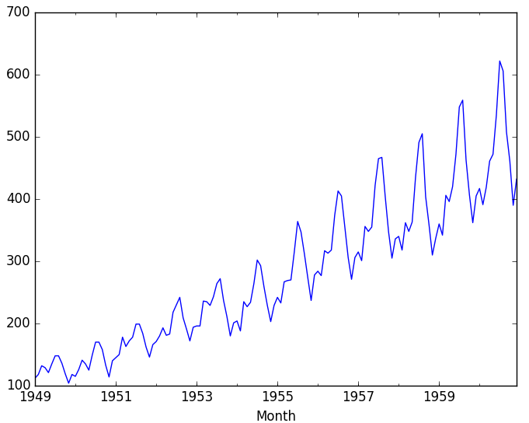
Introduction
Traditional Neural Network assumes that all inputs and outputs are independent of each other.
Example 1 : Stock exchange rate
Example 2 : language/speech modelling (NLP)
Predicting the next word in a sentence depends on the entire sequence of words
E.g. 1 : the clouds are in the …
E.g. 2 : I grew up in France, so I speak fluent …..
Sky
Sequence of learning!
French

Slide 4

Sequence of learning representation
Next data depends on previous data
Roughly equivalent to predicting what comes next
One RNN is trained, it is able to generate the future value (generative)
In the last few years, there have been incredible success applying RNNs to a variety of problems: time series prediction, speech recognition, language modeling, translation, image captioning

Slide 5

Sequence of learning representation in Neural Nets
unrolled
a chunk of neural network A. looks at some input x_{t} and outputs a value h_{t}
A recurrent neural network can be thought of as multiple copies of the same network, each passing a message to a successor

Slide 6
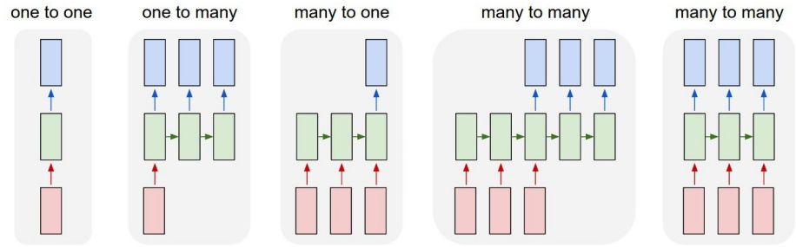
Variant of RNN
Vanilla model (without RNN), e.g: image classification

Slide 7
Variant of RNN
e.g. Image Captioning
Image -> sequence of words

Slide 8
Variant of RNN
e.g. sentiment analysis where a given sentence
sequence of words -> positive or negative sentiment

Slide 9
Variant of RNN
e.g. Machine Translation
seq. of words -> seq. of words

Slide 10
Variant of RNN
e.g. Video classification on frame level

Slide 11
RNN Calculation
y
Usually want to
Predict a vector at
Some time steps
RNN
x

Slide 12
Recurrent Neural Networks
We can process a sequence of vectors x by
Applying a recurrence formula at every time step:
Y_{t-1}
Y_{t}
….
h_{t-1}
h_{t}
….
new state
some function
With parameters W
old state
input vector at
some time step
X_{t-1}
X_{t}

Slide 13
Recurrent Neural Networks
We can process a sequence of vectors x by
Applying a recurrence formula at every time step:
Y_{t-1}
Y_{t}
….
h_{t-1}
h_{t}
….
Notice: the same function and the same set
Of parameters are used at every time step.
X_{t-1}
X_{t}

Slide 14
Recurrent Neural Networks
(Vanilla) Recurrent Neural Network
The state consists of a single “hidden” vector h:
Y_{t-1}
Y_{t}
….
h_{t-1}
h_{t}
….
X_{t-1}
X_{t}

Slide 15
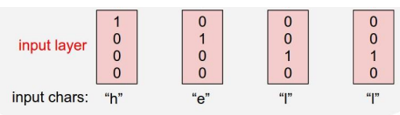
Character-level language modelling
Given a sequence of character, RNN predicts the probability of next character given the previous ones
Input/output words are encoded as one-hot vector.
We must provide the RNN all the dictionary of interest
Vocabulary:
[h,e,l,o]
Example training
Sequence:
“hello”

Slide 16
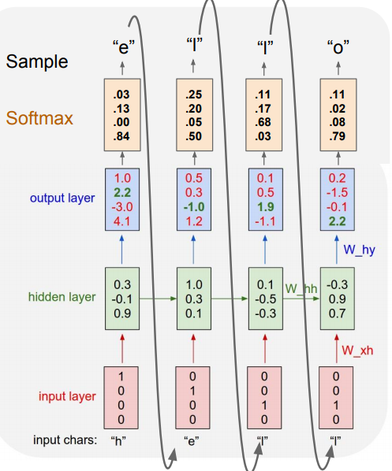
Character-level language modelling
Vocabulary:
[h,e,l,o]
Example training
Sequence:
“hello”
In the output layer, we want the green
numbers to be high and red numbers to be low

Slide 17
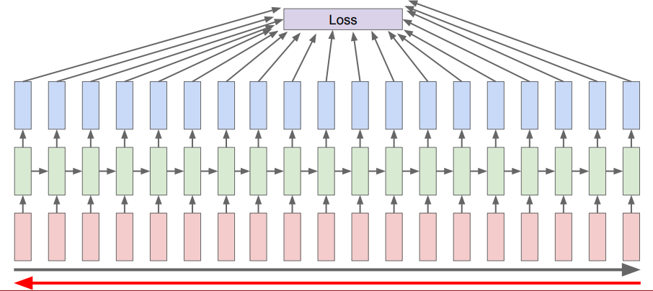
RNN Backpropagation
Backpropagation through time
Forward through entire sequence to
compute loss, then backward through
Entire sequence to compute gradient

Slide 18
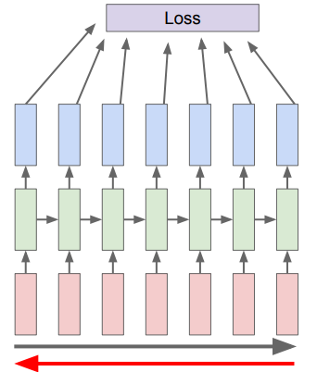
RNN Backpropagation
Truncated backpropagation through time
Run forward and backward
through chunks of the
sequence instead of whole
sequence

Slide 19
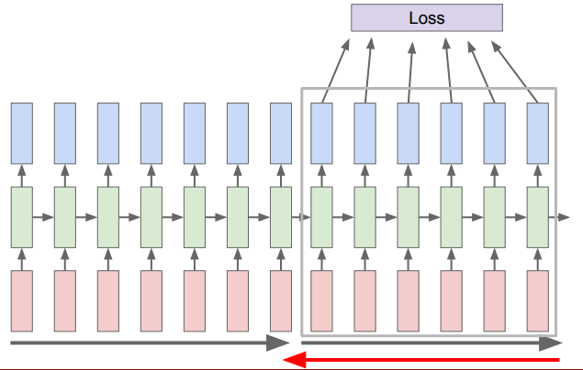
RNN Backpropagation
Truncated backpropagation through time
Carry hidden states
Forward in time forever,
But only backpropagate
For some smaller
Number of steps

Slide 20
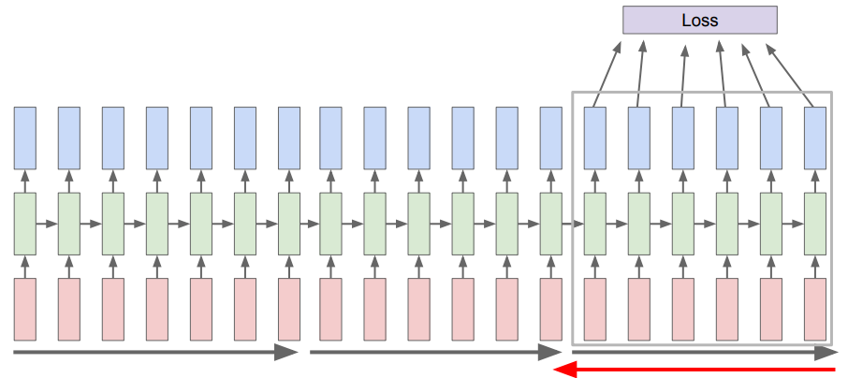
RNN Backpropagation
Truncated backpropagation through time

Slide 21
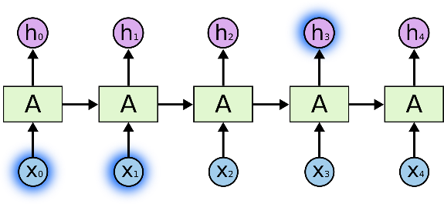
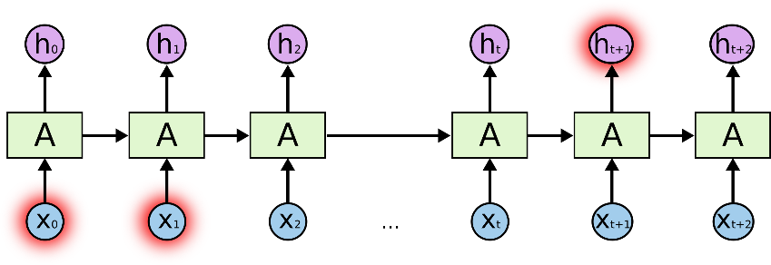
The Problem of Long-Term Dependencies
The clouds are in the …..
I grew up in France for ten years with my granny, so I speak fluent …..
sky
Easy ! the gap between the relevant information and
the place that it’s needed is small
RNN fails in long-term case!
French
Tough ! the gap between the relevant information and
the place that it’s needed is too far (long-term depency)

Slide 22
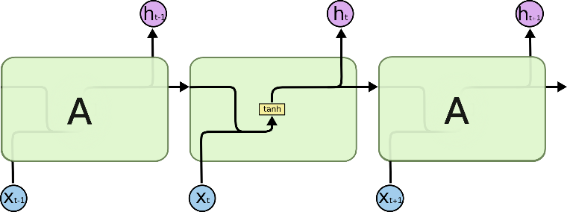

LSTM Networks
Long Short Term Memory networks – usually just called “LSTMs” – are a special kind of RNN.
LSTMs are explicitly designed to avoid the long-term dependency problem
The repeating module in a standard RNN contains a single layer
The repeating module in an LSTM contains four interacting layers

Slide 23

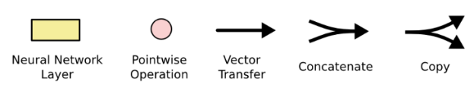
LSTM Networks
The processing unit of the LSTM is called a cell
An LSTM cell is composed of 4 layers, interacting with each other in a special way

Slide 24

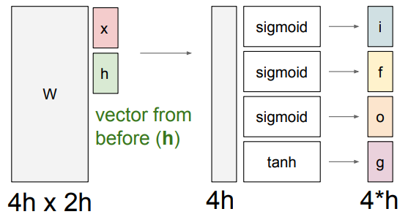
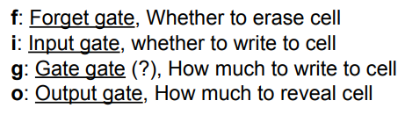
LSTM Networks

Slide 25
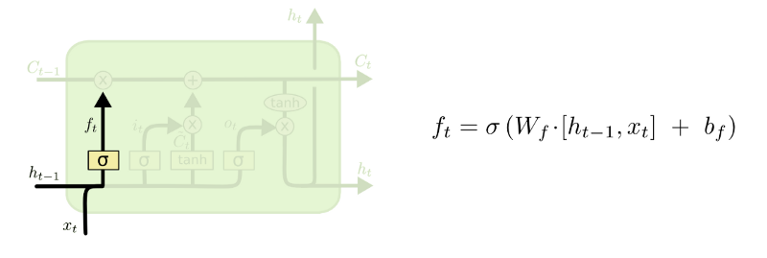
Forget gate operation
Take the input from current time step and the learned representation from previous time step and concatenate them.
Pass the concatenated value into a sigmoid function which outputs a value(f_t) between 0 and 1
0 it means forget
1 it means remember

Slide 26
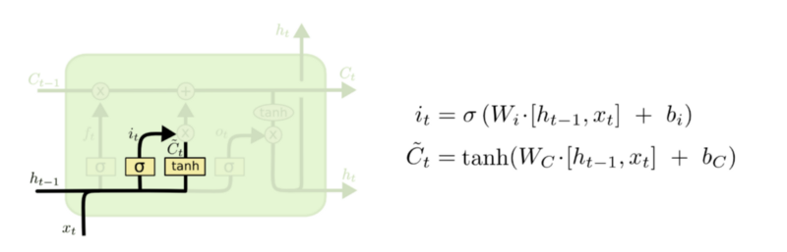
Update gate operation
Concatenate values from current time step and the learned representation from previous time step
By passing the concatenated values through a tanh function we generate candidate values
By passing it through a sigmoid function we choose which values to be selected from the candidates

Slide 27
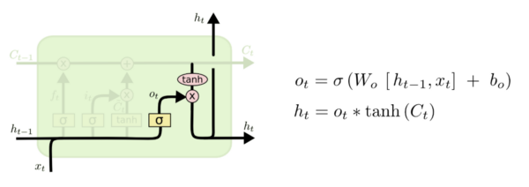
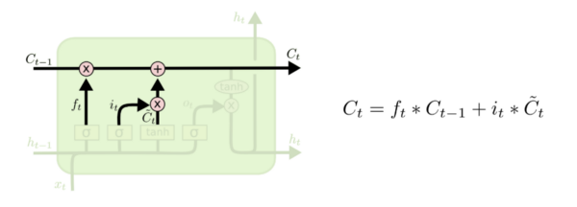
Output gate operation
Concatenate values from current time step and the learned representation from previous time step and pass it through a sigmoid function to choose which values we are going to use as the output

Slide 28
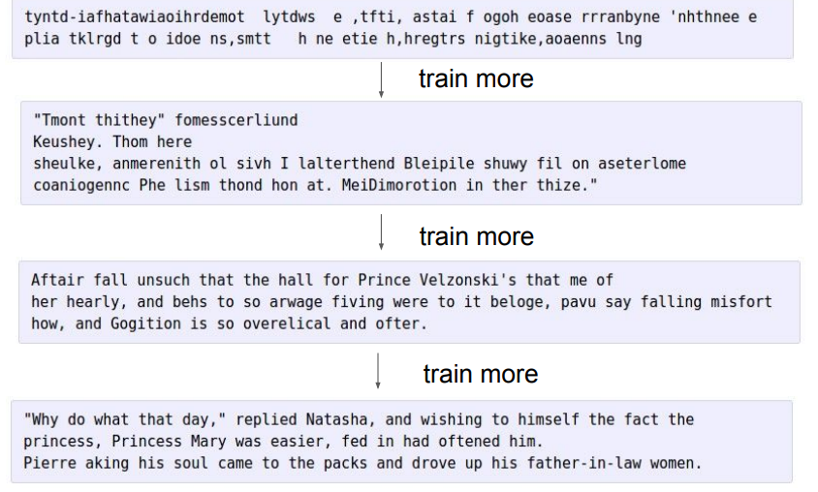
RNN & LSTM application
at first:
Learning from books
and generating texts

Slide 29
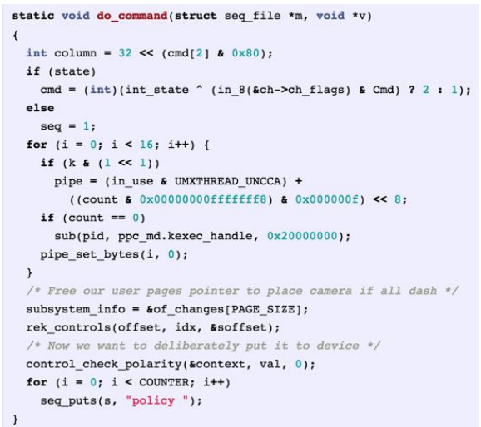
RNN & LSTM application (1)
Learning from some C codes,
And generating the C codes

Slide 30

RNN & LSTM application (2)
Natural Language
Generation: Shakespeare
Dataset: all the works of Shakespeare,
concatenated them into a single (4.4MB) file.
3-layer RNN with 512 hidden nodes on each layer.
Few hours of training

Slide 31
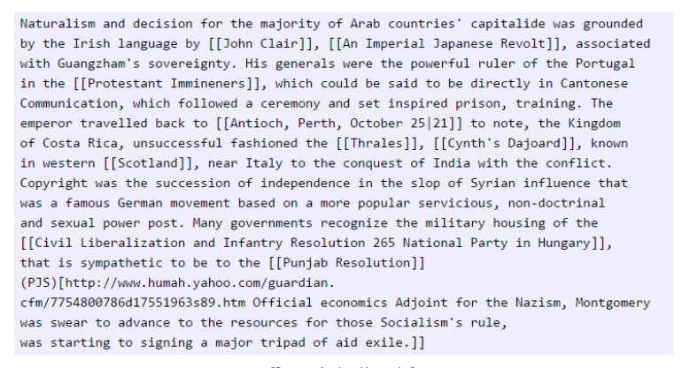
RNN & LSTM application (3)
Text Generation:
WIKIPEDIA
100MB dataset of raw Wikipedia
LSTM

Slide 32
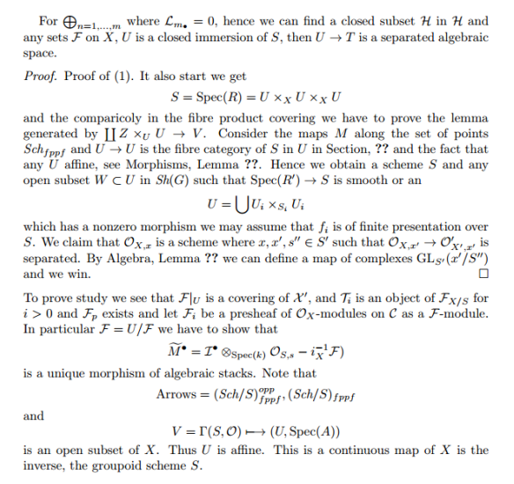
RNN & LSTM application (4)
Text Generation:
SCIENTIFIC PAPER
RNN trained on a book (LaTeX source code of 16MB)
Multilayer LSTM

Slide 33
LSTM in Predicting Time Series Data
One-step Univariate Forecasting
Multi-step Univariate Forecasting
t-1
t
t-1
t
t-2
t-1
t
X
Y
X
Y
X
Y
Y
1
2
3
4
5
7
8
9
2
3
4
5
7
8
9
nan
1
2
3
4
5
7
8
2
3
4
5
7
8
9
1
2
3
4
5
7
2
3
4
5
7
8
3
4
5
7
8
9

Slide 34
References
http://karpathy.github.io/2015/05/21/rnn-effectiveness/
Cs231n Stanford University Course

Slide 35
Thank You
Imam Mustafa Kamal

